Slide 1
Weekend Summary
Main tasks - goals:
Finish LBDS measurements at 450 GeV:
Beam dump with transverse and energy offsets.
Simulation of asynchronous beam dump.
Adjustment of TOTEM Roman Pots at 450 GeV.
Optimization of longitudinal blow-up procedure.
Fills for Physics.

Slide 2
Week 25
Week 24
Mon 21/6 | LBDS setup and validation at 450 GeV
Tue 22/6 | LBDS and collimation validation continued Cryo problem in Pt4
Wed 23/6 | Access for RB78 and BIC/RF IR4. Cryo recovery (Pt4 and Pt2) Technical stop in the SPS; RF problems in injector complex
Thu 24/6 | Feedback studies (Q, Q’ and Orbit); Damper tests Ramp test and asynch beam dump validation
Fri 25/6 | Finishing up LBDS validation TOTEM setup at 450 GeV Transverse damper setting-up for operation with >1 bunch
Sat 26/6 | Test ramp with new sequence for squeeze and collapsing of separator bumps. Fill for Physics with 'Stable Beam' conditions ➔ L = 5 10²⁹ cm⁻² sec⁻¹
Sun 27/6 | End of fill studies on Q’; Octupole settings and beam size measurement Loss of cryo in Sector 34 ➔ no beam for rest of the day

Slide 3
Saturday 26.6
Summary of Saturday’s Physics fill’:
Emittances of beams at end of ramp:
Beam1: horizontal 5.0 μm; vertical 7.6 μm
Beam2: horizontal 6.0 μm; vertical 5.9 μm
Peak luminosity above 5 10²⁹ cm⁻² sec⁻¹!
But luminosity in ALICE ca. factor 2 smaller than in other experiments!
N_{b} = 0.9 10¹¹ ppb
Measured β* values:
IP1 (ATLAS) horizontal: 3.27m - 3.52m vertical: 3.82m - 3.76m
IP2 (ALICE) horizontal: 3.45m - 3.34m vertical: 2.65m - 4.23m
IP5 (CMS) horizontal: 3.70m - 3.69m vertical: 3.45m - 3.93m
IP8 (LHCb) horizontal: 3.42m - 3.64m vertical: 3.89m - 3.07m
➔ 2.4 10²⁹ cm⁻² sec⁻¹!!!

Slide 4
Sunday 27.6
Morning: End of Fill measurements for last physics fill:
Re measure Q’ (still looking for explanation of intensity drop during last fill):
Beam2: Q_{x}’ = +4.4; Q_{y}’ = +4.2
Re-measuring transverse emittances:
end of squeeze:
Beam1: horizontal 5.0 μm; vertical 7.6 μm
Beam2: horizontal 6.0 μm; vertical 5.9 μm
end of run:
Beam1: horizontal 5.6 μm; vertical 10.4 μm
Beam2: horizontal 10.6 μm; vertical 13.4 μm
Reducing Octupole strength (100A ➔ 40A).
No change in tune spectrum
But some losses in IR7

Slide 5
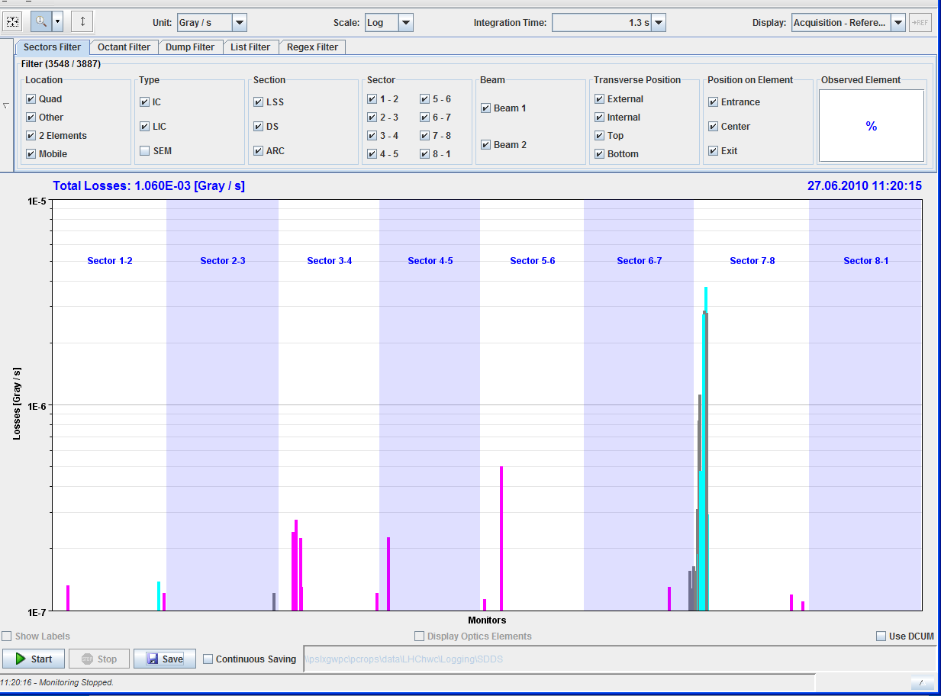
Sunday 27.6
Losses in IR7 during change of Octupole settings:

Slide 6
Sunday 27.6
Morning: End of Fill measurements for last physics fill:
Transverse offset scans at ALICE:
Horizontal scan with both beams at 1 σ ➔ Optimization for Horizontal rate is ok.
Vertical scan with both beams at 1 σ ➔ Optimization for Vertical rate is ok.
11:50: setting up for reducing the instantaneous luminosity by a factor of 30 for ALICE by opening the Horizontal separation.
12:10: Both beams dumped via SMP interlock in the SIS which was generated when the SMP detected an energy mis-match from the BLMs. The reason for the mismatch was due to a BLM crate being down (cfv-sr7-BLMR).
12:18: Ramp down.
14:00: Ready to inject.
15:33: Lost cryo conditions in sector 34: the 4.5 K cold compressor is down. We are probably out for 10-12 hours.

Slide 7
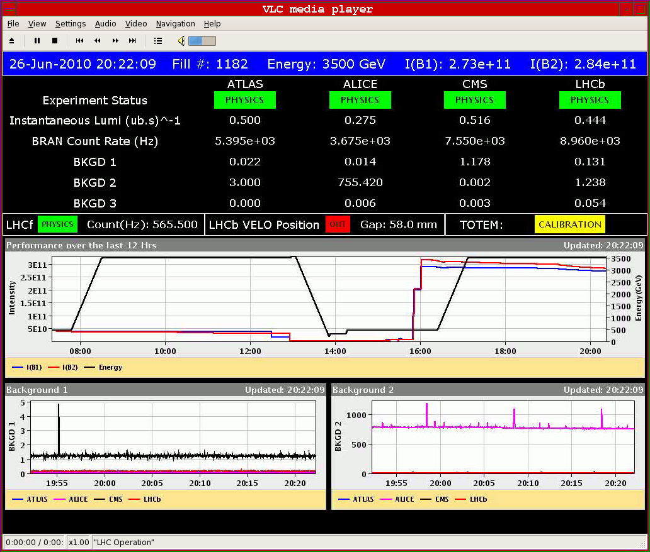
Saturday 26.6
Stable beams with L ≈ 5 10²⁹ cm⁻² sec⁻¹:

Slide 8
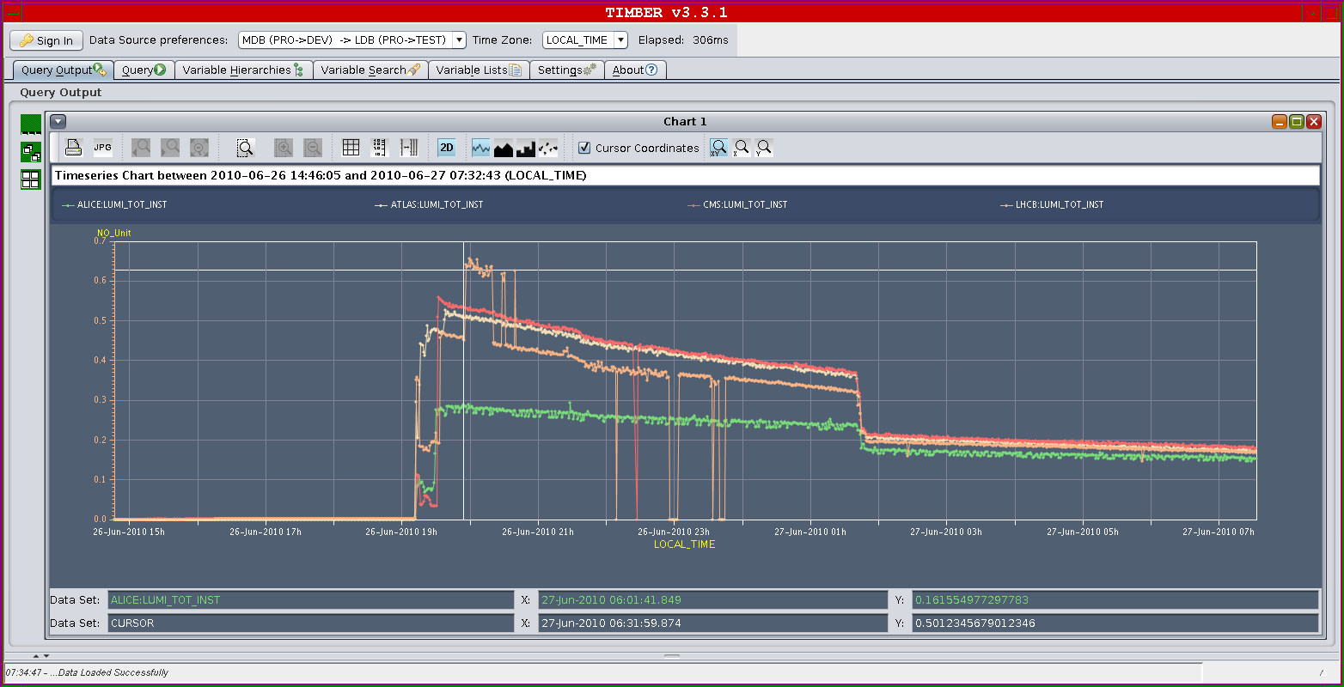
Sunday 27.6
Luminosity over fill:

Slide 9
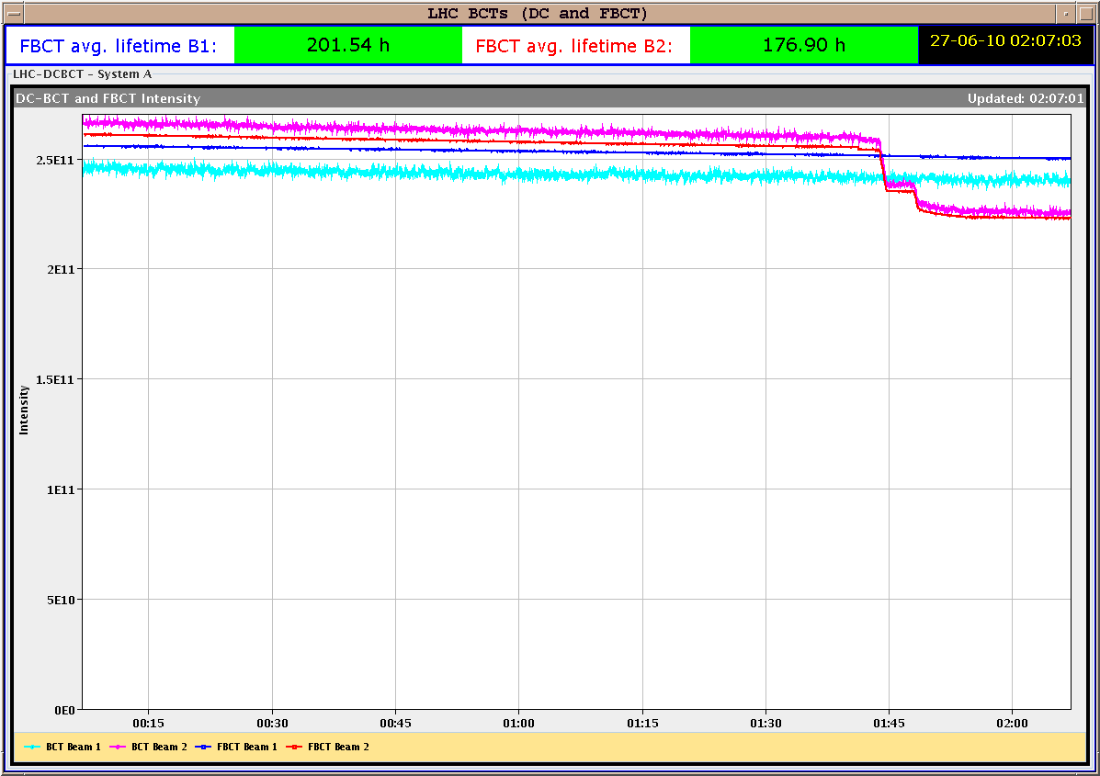
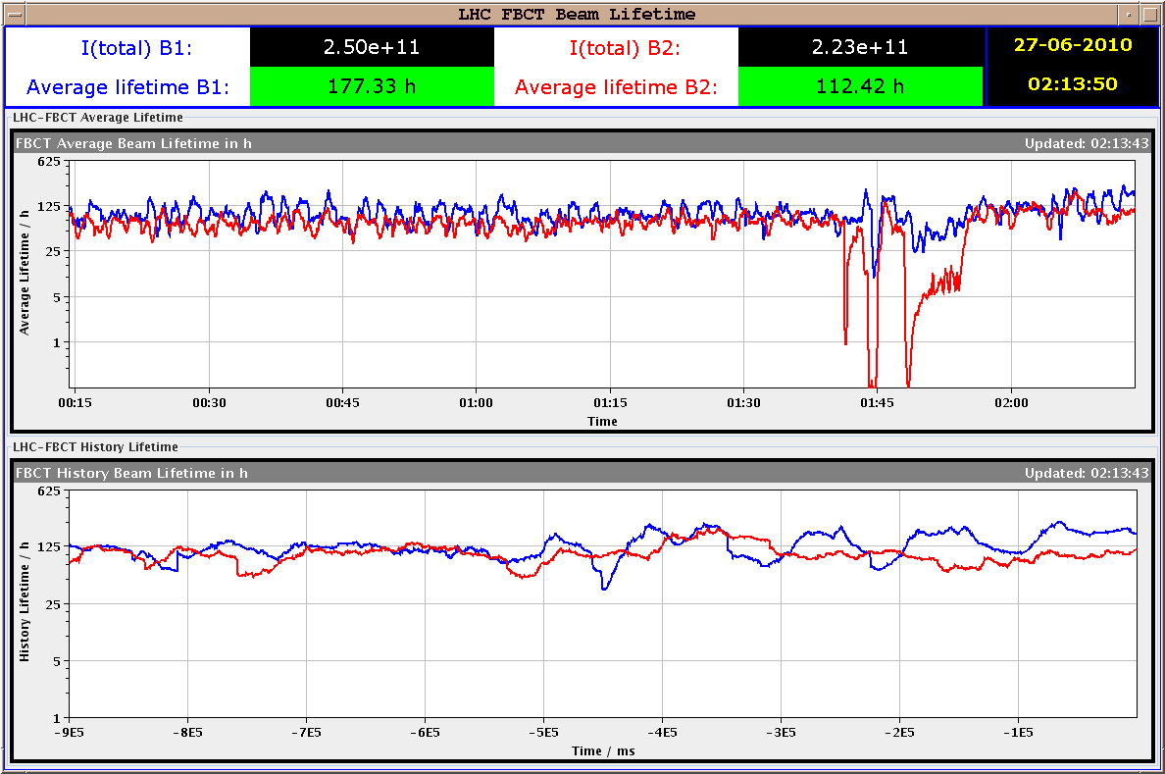
Sunday 27.6
Intensity and lifetime versus time:

Slide 10
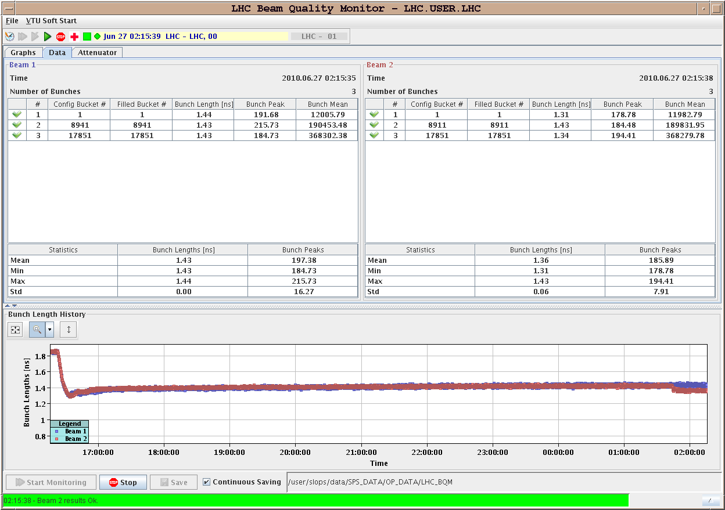
Sunday 27.6
Bunch length versus time:

Slide 11
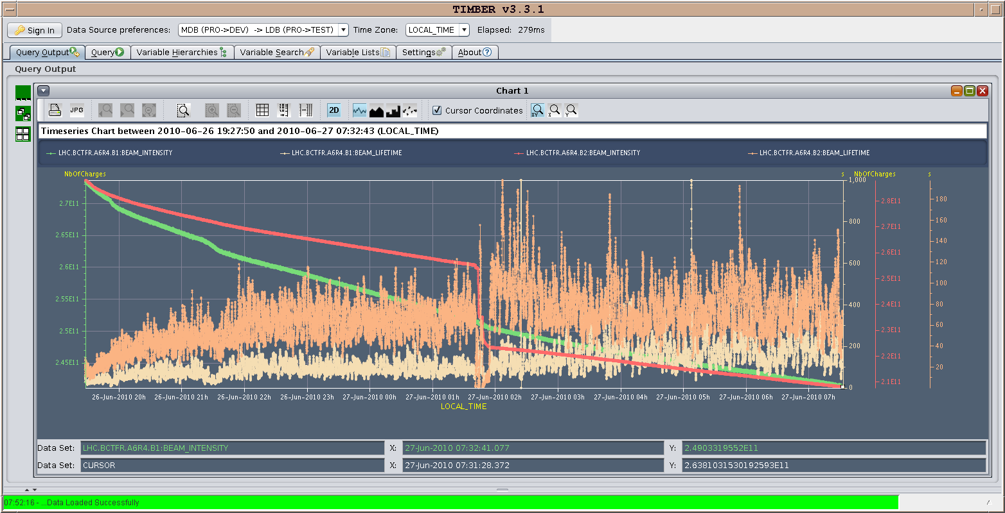
Sunday 27.6
Beam intensity and lifetime:

Slide 12
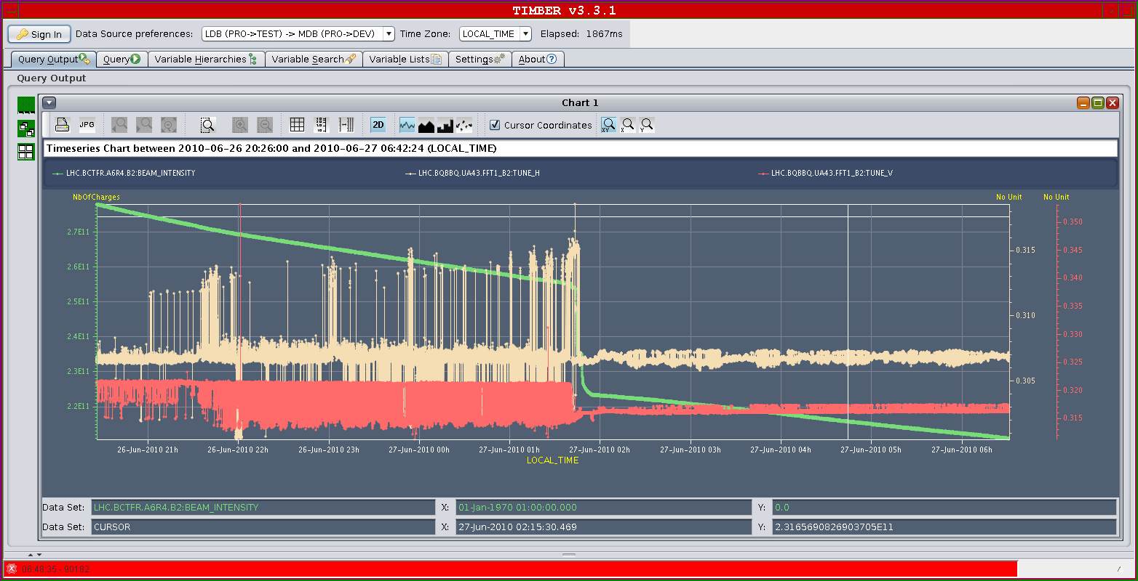
Sunday 27.6
Beam1 Tune lines and intensity: ΔQ_{v} = 5 10⁻³

Slide 13
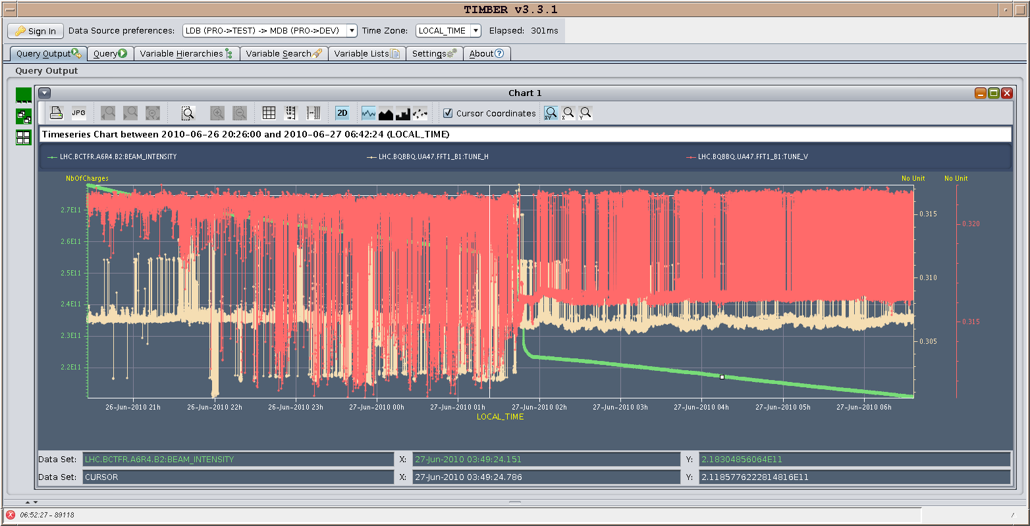
Sunday 27.6
Beam1 Tune lines and intensity: ΔQ_{v} = 5 10⁻³

Slide 14
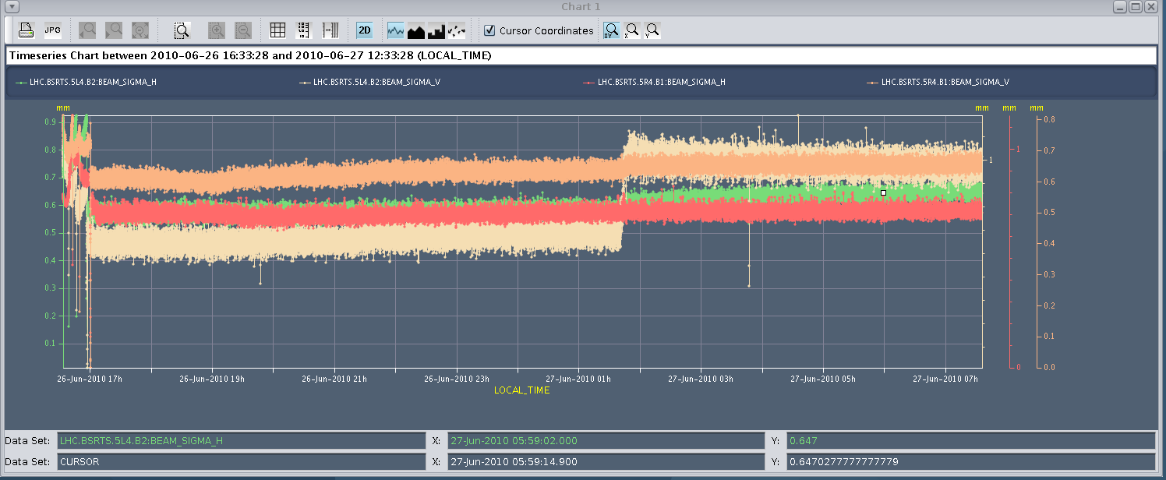
Sunday 27.6
Beam size from synchrotron light monitor (average):
Philippe mentions later that only bunches 1 and 3 saw their length decreased down to 1.3 ns

Slide 15
Monday 28.6
Plan for the weekend:
Physics fills with 3 on 3 10¹¹ppb.
Horizontal beam separation for ALICE with aim of factor 30 luminosity reduction.
Hump measurements at 450 GeV (if time permits).

